Slide 1
Hidden Markov Models
Christian M. Adriano (Chris)
christian.adriano@hpi.de
Notes:
https://en.wikipedia.org/wiki/Transduction_(machine_learning)

Slide 2
Motivation
Context: Sequence data can have correlations (non-i.i.d.) which can be exploited to make predictions:
Weather forecast
Speech recognition
Robot localization
Activity recognition
Problems:
How to estimate states given observation (prediction problem)?
How to produce observations given states (data generation problem)?
Solution is to assume that:
states are not always visible
only observations are visible

Slide 3
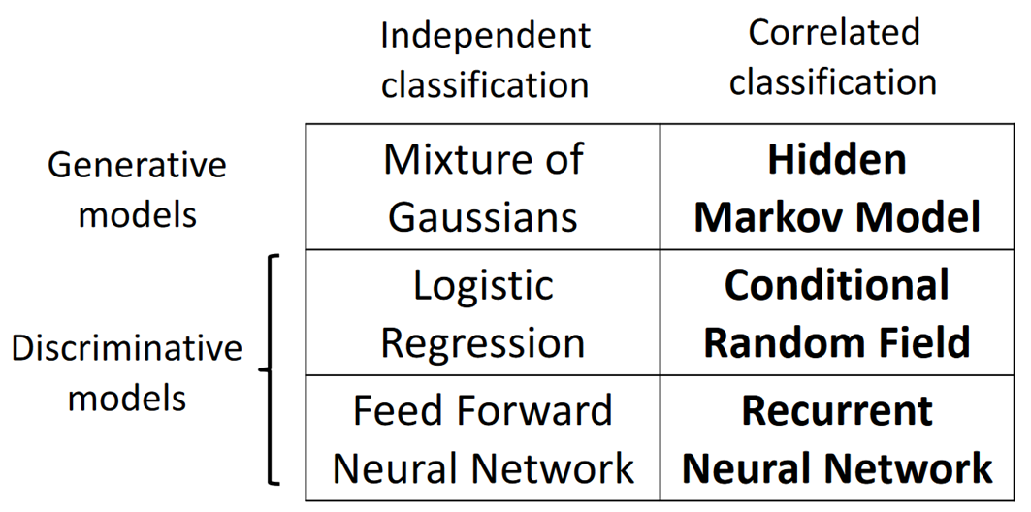

Models for sequential data
source:

Slide 4
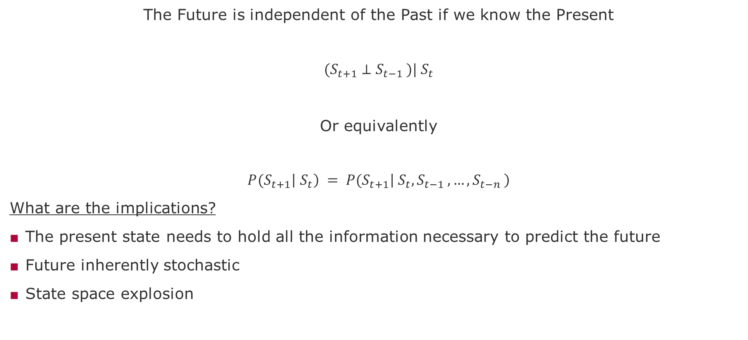
Markov Property
The Future is independent of the Past if we know the Present
$${(S}_{t+1} ⊥S_{t−1 })|{ S}_{t}$$
Or equivalently
$${P(S}_{t+1}\left|{ S}_{t}\right) = {P(S}_{t+1}\left|{ S}_{t},S_{t−1 },…,S_{t−n }\right)$$
What are the implications?
The present state needs to hold all the information necessary to predict the future
Future inherently stochastic
State space explosion

Slide 5
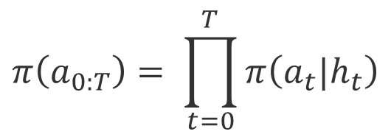
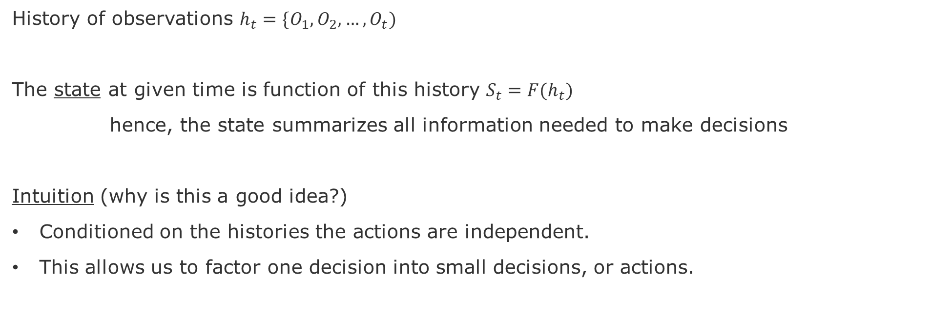
State
History of observations $h_{t}=\{O_{1},O_{2}, …,O_{t})$
The state at given time is function of this history $S_{t}=F(h_{t})$
hence, the state summarizes all information needed to make decisions
Intuition (why is this a good idea?)
Conditioned on the histories the actions are independent.
This allows us to factor one decision into small decisions, or actions.
$$π\left(a_{0:T}\right)= \prod_{t=0}^{T}{π\left(a_{t}|h_{t}\right)}$$

Slide 6

Agent and Environment Interaction
Action
Agent
Environment
State
Observation
Reward
Agent’s Goal: Maximize its reward
Our Goal: Discover a strategy that allows the agent to achieve its goal under various circumstances
Search, Estimate, Learn
Policy = $π(S,A)$
knowlege about the environment

Slide 7


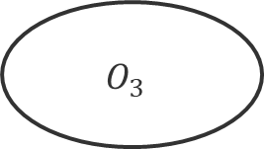
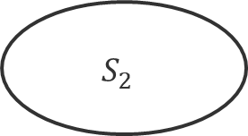


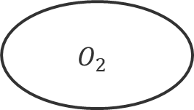
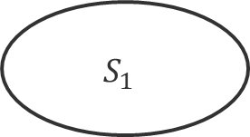
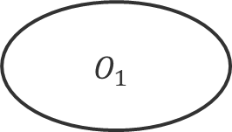





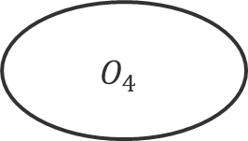


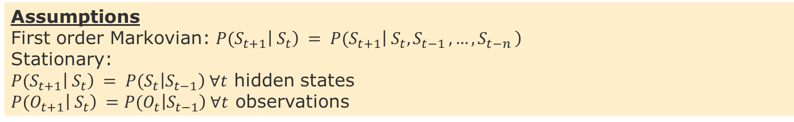
Hidden Markov Model
$$0.3$$
$$0.5$$
$$0.5$$
$$S_{1}$$
$$S_{3}$$
$$0.5$$
$$0.1$$
$$0.6$$
$$S_{4}$$
Hidden states
$$S_{2}$$
$$0.3$$
$$1.0$$
End
$$0.2$$
$$O_{1}$$
$$O_{2}$$
$$O_{3}$$
$$O_{4}$$
Observations
Assumptions
First order Markovian: ${P(S}_{t+1}\left|{ S}_{t}\right) = {P(S}_{t+1}\left|{ S}_{t},S_{t−1 },…,S_{t−n }\right)$
Stationary:
${P(S}_{t+1}\left|{ S}_{t}\right) = {P(S}_{t}\left|S_{t−1}\right) ∀t$ hidden states
${P(O}_{t+1}\left|{ S}_{t}\right) ={P(O}_{t}\left|S_{t−1}\right) ∀t$ observations

Slide 8
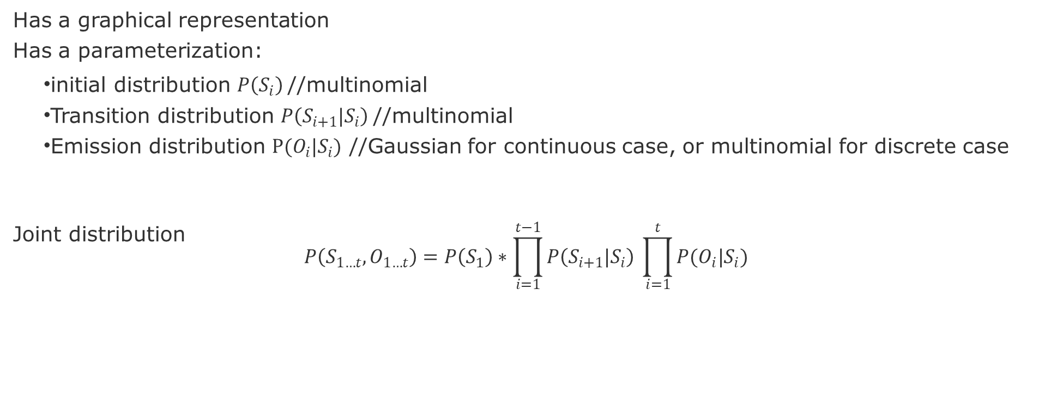
Definition for HMM
Has a graphical representation
Has a parameterization:
initial distribution $P\left(S_{i}\right)$//multinomial
Transition distribution $P\left(S_{i+1}|S_{i}\right)$//multinomial
Emission distribution $P(O_{i}|S_{i})$ //Gaussian for continuous case, or multinomial for discrete case
Joint distribution
$$P\left(S_{1…t},O_{1…t}\right)=P\left(S_{1}\right)∗\prod_{i=1}^{t−1}{P\left(S_{i+1}|S_{i}\right) \prod_{i=1}^{t}{P(O_{i}|S_{i})}}$$

Slide 9
Applications of Hidden Markov Model (HMM)
Speech recognition
Robot localization
Patient monitoring
Weather prediction
Stock market prediction
Monitoring Algorithm
Prediction Algorithm
Other algorithms:

Slide 10
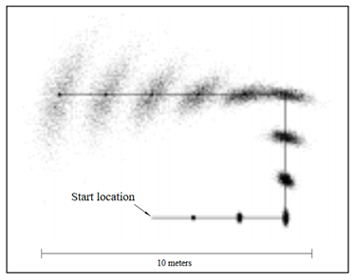
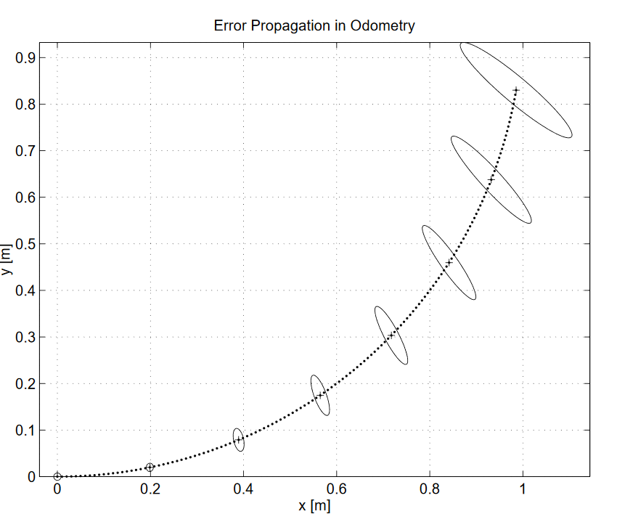
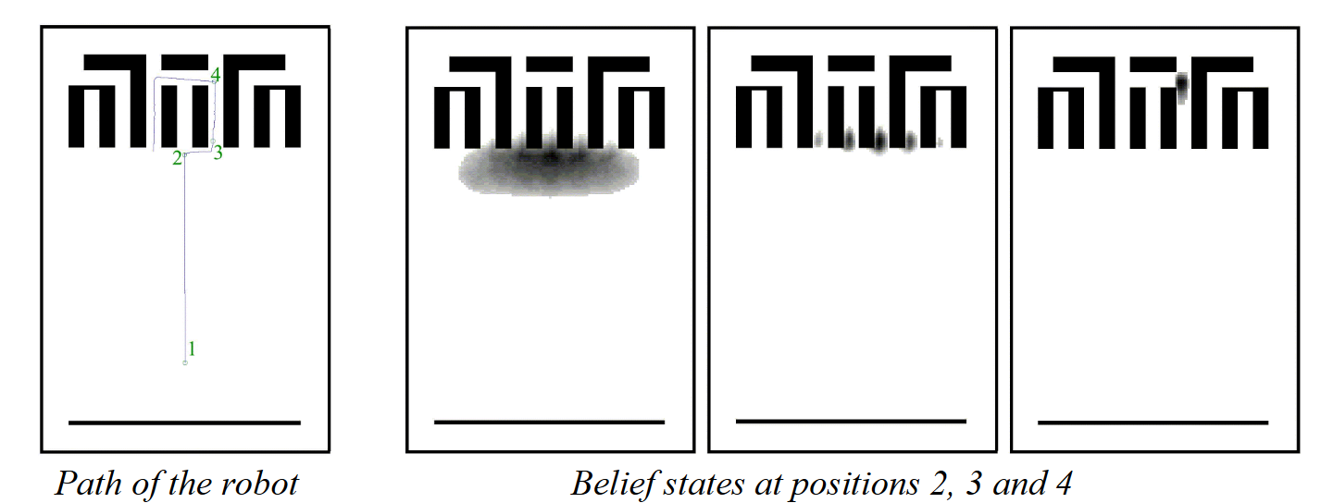
Robot Localization
Given the following…
S = coordinates of the robot in space
O = distances to objects measured by a lidar (laser beam)
P(S_{t}|S_{t-1}): transitions of the robot (inherently uncertain)
P(O_{t}|S_{t}): uncertainty in the measurements provided by the laser beam
What is the robot’s localization P(S_{t}|O_{1…t})?
source: Fox et al., 1999, Monte Carlo Localization: Efficient Position Estimation for Mobile Robots
source: http://www.cs.cmu.edu/~rasc/ Download/AMRobots5.pdf
source: Choset et al., (2005). Principles of robot motion: theory, algorithms, and implementation. MIT press.
Notes:
source: http://www.cs.cmu.edu/~rasc/Download/AMRobots5.pdf
Fox et al., 1999, Monte Carlo Localization: Efficient Position Estimation for Mobile Robots

Slide 11
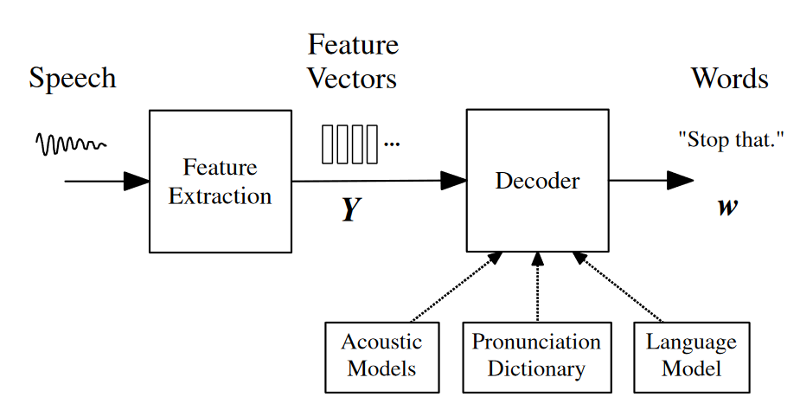
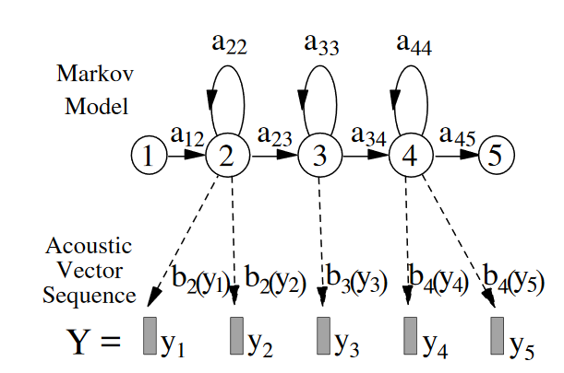
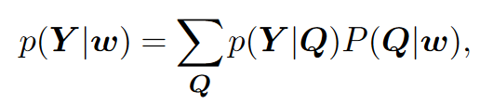
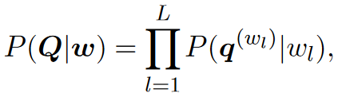
Speech recognition
Each spoken word w is decomposed into a sequence of q^{w} basic sounds called base phones. This sequence is called its pronunciation q(w)1:q^{w}=q¹,...,q^{w}. To allow for the possibility of multiple pronunciations, the likelihood p(Y|w) can be computed over multiple pronunciations.
where the summation is over all valid pronunciation sequences for w, Q is a particular sequence of pronunciations
and where each q(w_{l}) is a valid pronunciation for word w_{l}
source: Gales, M., & Young, S. (2008). The application of hidden Markov models in speech recognition. Now Publishers Inc.
Notes:
HMM is simple and effective framework to model time-varying spectral vector sequences
Large vocabulary continuous speech recognition (LVCSR).
Gales, M., & Young, S. (2008). The application of hidden Markov models in speech recognition. Now Publishers Inc.

Slide 12
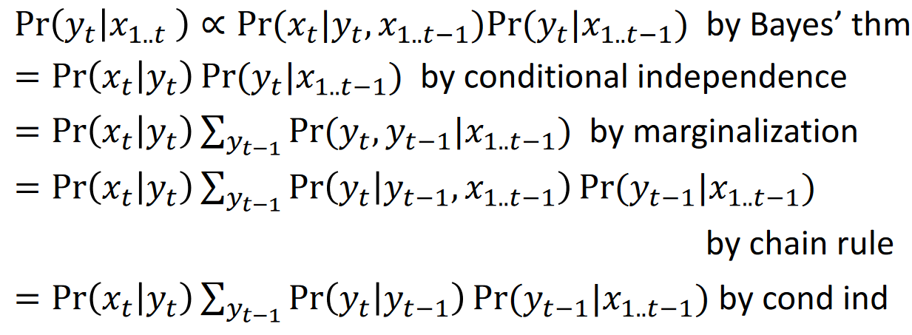
Monitoring algorithm
Pr(Y_{t}|X_{1...t}): Distribution over current state (Y_{t}) given observations X_{1...t}
Recursive Computation:
Prediction of my observation
State transitions
State probability given history of observations
source:

Slide 13
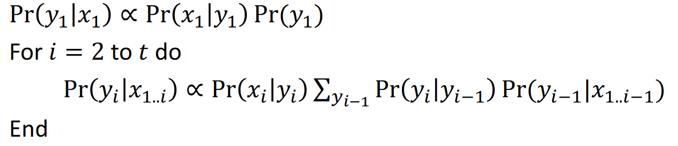
Forward computation
Compute Pr(Y_{t}|X_{1...t}) by forward computation:
From Bayes Rule
From the Recursive Computation
source:

Slide 14
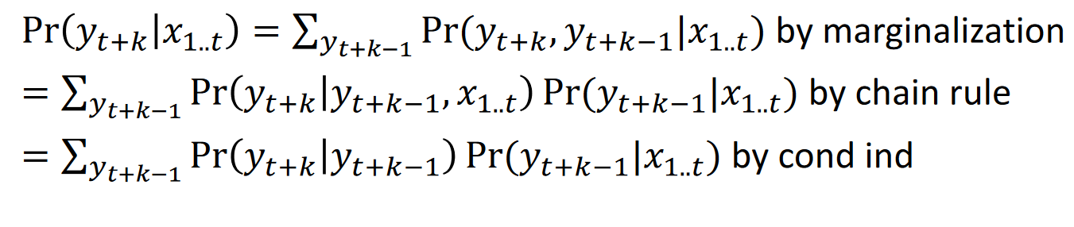
Prediction Algorithm
Pr(Y_{t+k}|X_{1...t}): Distribution over future states (Y_{t+k}) given observations X_{1...t}
Recursive Computation:
Future State transitions
Future State probability given history of observations
source:

Slide 15
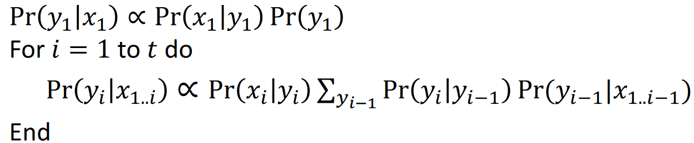
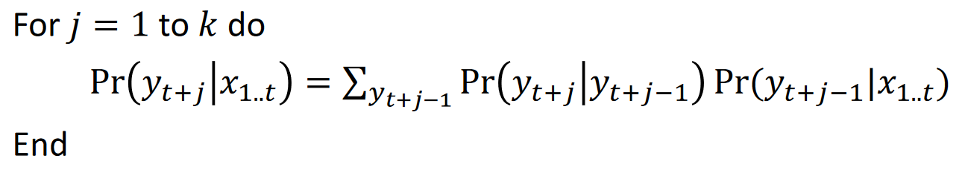
Forward computation
1. Compute Pr(Y_{t}|X_{1...t}) by forward computation (same step as before).
2. Compute Pr(Y_{t+k}|X_{1...t}) by forward computation
source:

Slide 16
Topics
Review of Baum-Welch Algorithm
Example
HMMLearn API
Tasks

Slide 17
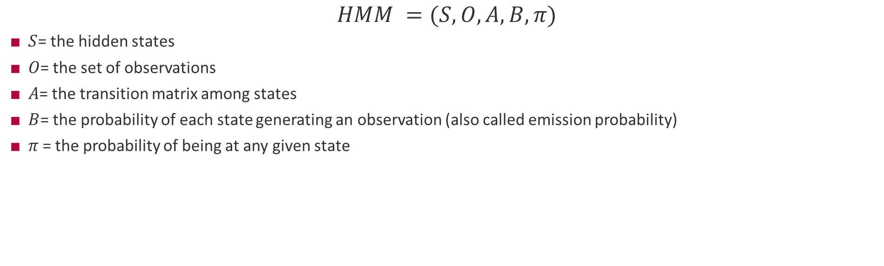
HMM definitions used
$$HMM =(S, O, A, B, π)$$
$S$= the hidden states
$O$= the set of observations
$A$= the transition matrix among states
$B$= the probability of each state generating an observation (also called emission probability)
$π$= the probability of being at any given state
Reference:
Rabiner, L. R. (1989). A tutorial on hidden Markov models and selected applications in speech recognition. Proceedings of the IEEE, 77(2), 257-286.

Slide 18
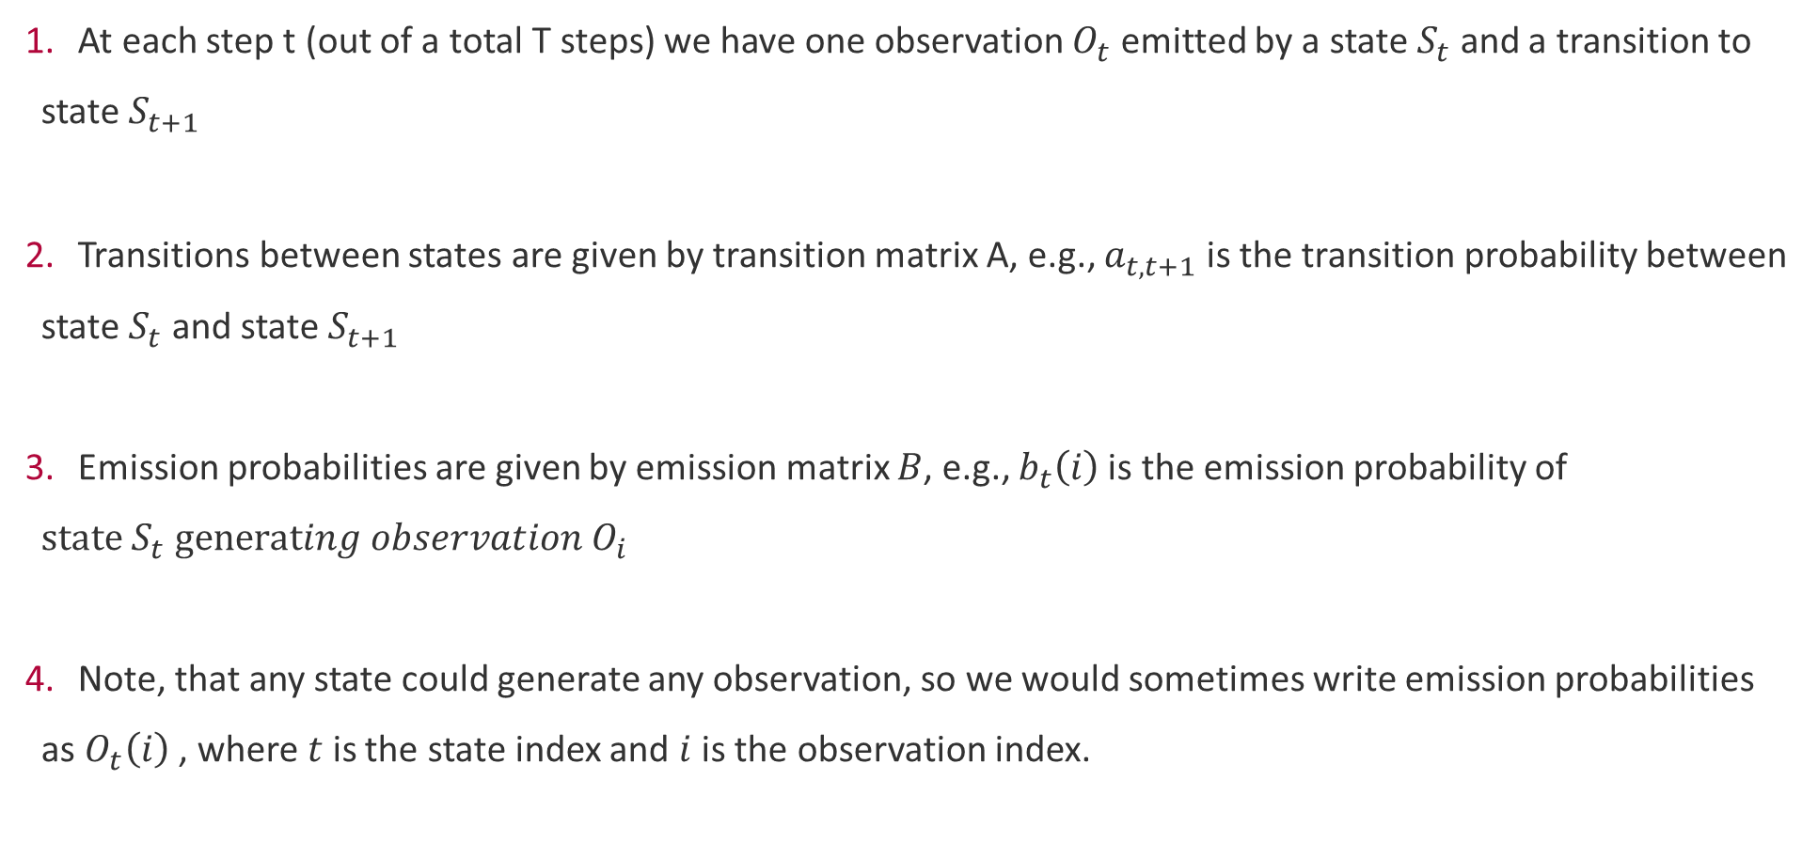
How the HMM works
At each step t (out of a total T steps) we have one observation $O_{t}$ emitted by a state $S_{t}$ and a transition to state $S_{t+1}$
Transitions between states are given by transition matrix A, e.g., $a_{t,t+1}$ is the transition probability between state $S_{t}$ and state $S_{t+1}$
Emission probabilities are given by emission matrix $B$, e.g., $b_{t}\left(i\right)$is the emission probability of $state S_{t} generating observation O_{i}$
Note, that any state could generate any observation, so we would sometimes write emission probabilities as $O_{t}\left(i\right)$ , where $t$ is the state index and $i$ is the observation index.

Slide 19
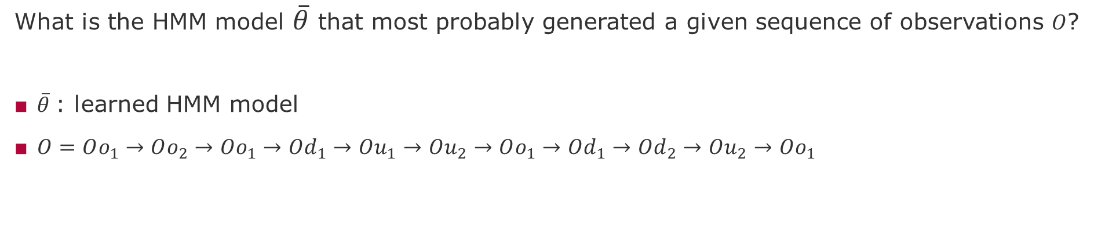
Baum-Welch algorithm GOAL
What is the HMM model $\overline{θ}$ that most probably generated a given sequence of observations $O$?
$\overline{θ}$: learned HMM model
$O=Oo_{1}→Oo_{2}→Oo_{1}→Od_{1}→Ou_{1}→Ou_{2}→Oo_{1}→Od_{1}→Od_{2}→Ou_{2}→Oo_{1}$

Slide 20
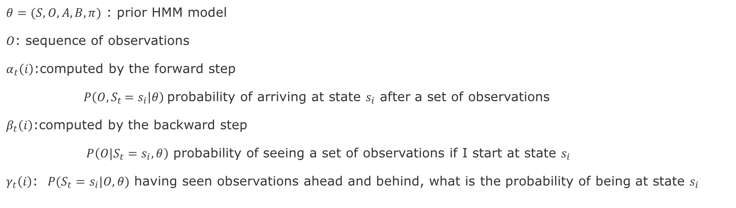
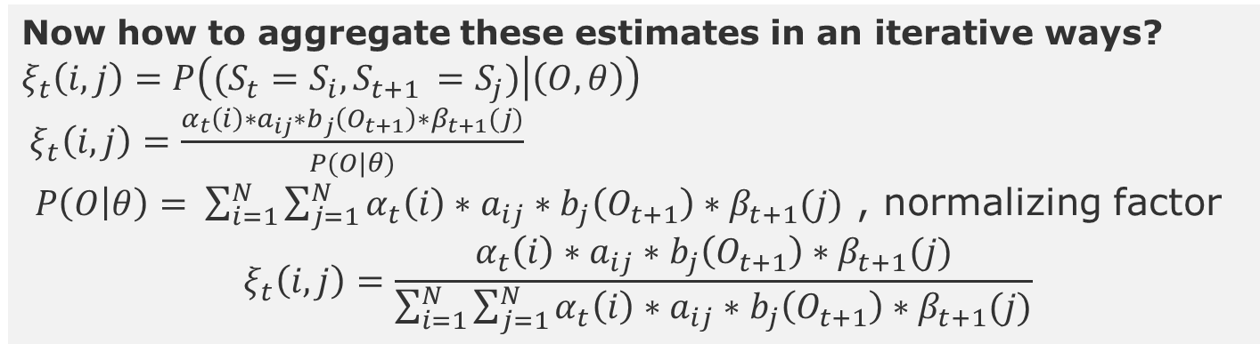
Baum-Welch Algorithm: Components
$θ=(S, O, A,B,π)$ : prior HMM model
$O$: sequence of observations
$α_{t}\left(i\right)$:computed by the forward step
$P\left(O{,S}_{t}=s_{i} | θ\right)$ probability of arriving at state $s_{i}$ after a set of observations
$β_{t}\left(i\right)$:computed by the backward step
$P\left(O{|S}_{t}=s_{i}, θ\right)$ probability of seeing a set of observations if I start at state $s_{i}$
$γ_{t}\left(i\right)$: $P(S_{t}=s_{i}|O, θ)$ having seen observations ahead and behind, what is the probability of being at state $s_{i}$
Now how to aggregate these estimates in an iterative ways?
$$ξ_{t}\left(i,j\right)=P\left((S_{t}=S_{i}, S_{t+1 }=S_{j}) | \left(O, θ\right)\right)$$
${ ξ}_{t}\left(i,j\right)=\frac{α_{t}\left(i\right)∗a_{ij}∗b_{j}\left(O_{t+1}\right)∗β_{t+1}(j)}{P(O|θ)}$
$P\left(O | θ\right)= \sum_{i=1}^{N}{\sum_{j=1}^{N}{α_{t}\left(i\right)∗a_{ij}∗b_{j}\left(O_{t+1}\right)∗β_{t+1}(j)}}$ , normalizing factor
$${ ξ}_{t}\left(i,j\right)=\frac{α_{t}\left(i\right)∗a_{ij}∗b_{j}\left(O_{t+1}\right)∗β_{t+1}(j)}{\sum_{i=1}^{N}{\sum_{j=1}^{N}{α_{t}\left(i\right)∗a_{ij}∗b_{j}\left(O_{t+1}\right)∗β_{t+1}(j)}}}$$
Notes:
Introduce conditional operator P has two components P(C|C)

Slide 21
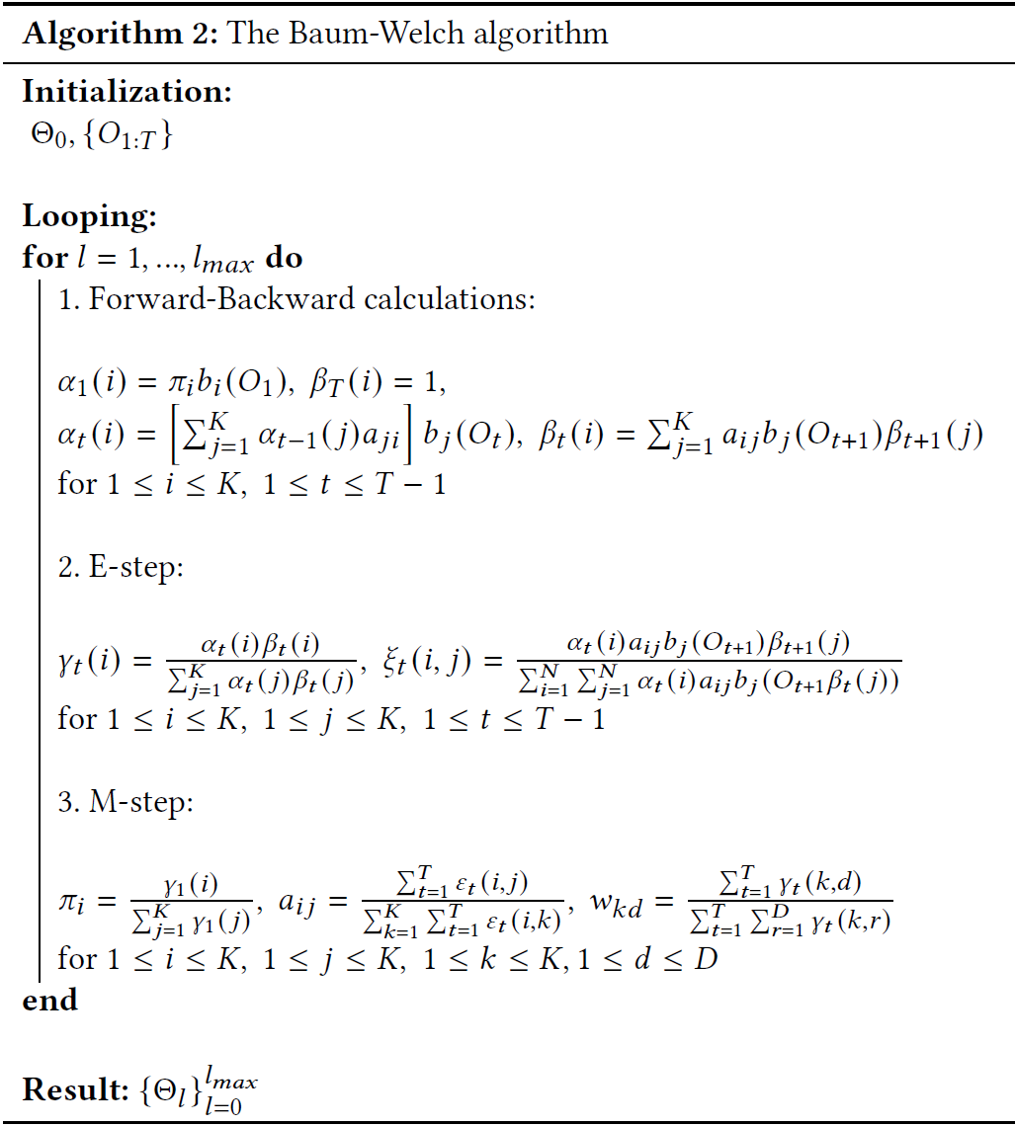
Baum-Welch Algorithm: Iterative Procedure

Slide 22
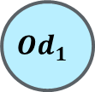
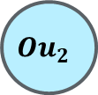
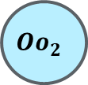

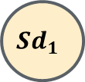
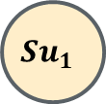




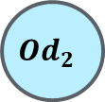
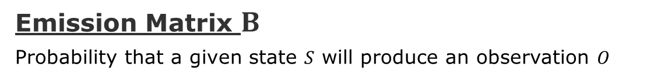
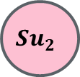

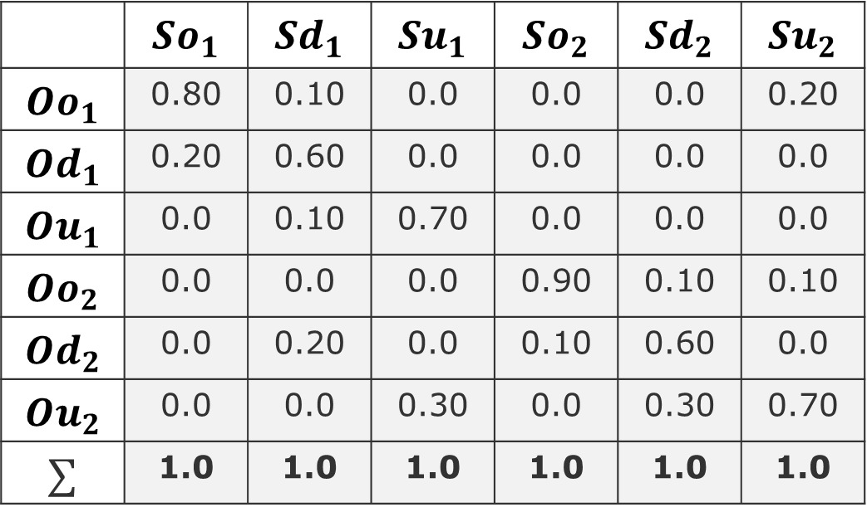

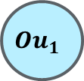
Example
Emission Matrix $B$
Probability that a given state $S$ will produce an observation $O$
$$So_{1}$$
Intermittent cycle
Effect of Failure Masking
$${Oo}_{1}$$
$${Od}_{1}$$
States
 | $$So_{1}$$ | $$Sd_{1}$$ | $$Su_{1}$$ | $$So_{2}$$ | $$Sd_{2}$$ | $$Su_{2}$$
$$Oo_{1}$$ | 0.80 | 0.10 | 0.0 | 0.0 | 0.0 | 0.20
$$Od_{1}$$ | 0.20 | 0.60 | 0.0 | 0.0 | 0.0 | 0.0
$${Ou}_{1}$$ | 0.0 | 0.10 | 0.70 | 0.0 | 0.0 | 0.0
$$Oo_{2}$$ | 0.0 | 0.0 | 0.0 | 0.90 | 0.10 | 0.10
$$Od_{2}$$ | 0.0 | 0.20 | 0.0 | 0.10 | 0.60 | 0.0
$${Ou}_{2}$$ | 0.0 | 0.0 | 0.30 | 0.0 | 0.30 | 0.70
$$∑$$ | 1.0 | 1.0 | 1.0 | 1.0 | 1.0 | 1.0
$$Sd_{1}$$
$${Oo}_{1}$$
$${Od}_{1}$$
$${Ou}_{1}$$
$${Od}_{2}$$
$$Su_{1}$$
$$Su_{2}$$
Observations
$${Ou}_{1}$$
$${Ou}_{2}$$
$${Oo}_{1}$$
$${Ou}_{2}$$
$${Oo}_{2}$$

Slide 23
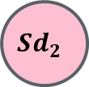




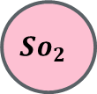

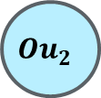


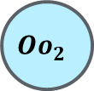


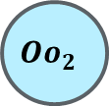

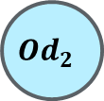

Emission Scenarios
$$So_{1}$$
$$So_{2}$$
$${Oo}_{1}$$
$${Od}_{1}$$
$${Oo}_{2}$$
$${Od}_{2}$$
$$Sd_{1}$$
$$Sd_{2}$$
$${Oo}_{1}$$
$${Od}_{1}$$
$${Ou}_{1}$$
$${Od}_{2}$$
$${Oo}_{2}$$
$${Od}_{2}$$
$${Ou}_{2}$$
$$Su_{1}$$
$$Su_{2}$$
$${Oo}_{1}$$
$${Ou}_{2}$$
$${Ou}_{1}$$
$${Ou}_{2}$$
$${Oo}_{2}$$

Slide 24
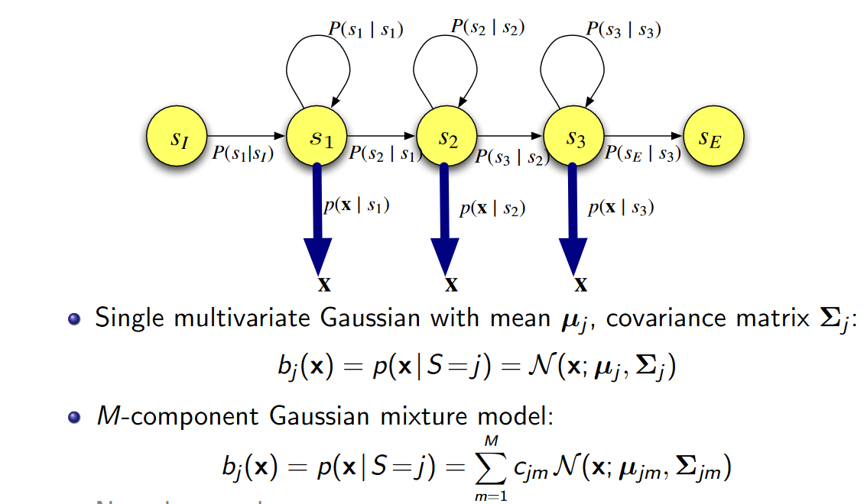
Output Distribution
Source: https://www.inf.ed.ac.uk/teaching/courses/asr/2017-18/asr03-hmmgmm-handout.pdf
Notes:
https://www.inf.ed.ac.uk/teaching/courses/asr/2017-18/asr03-hmmgmm-handout.pdf
Types of covariance matrix: https://stats.stackexchange.com/questions/326671/different-covariance-types-for-gaussian-mixture-models

Slide 25
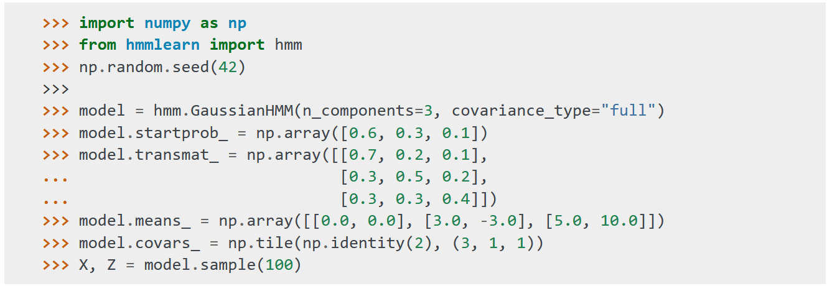
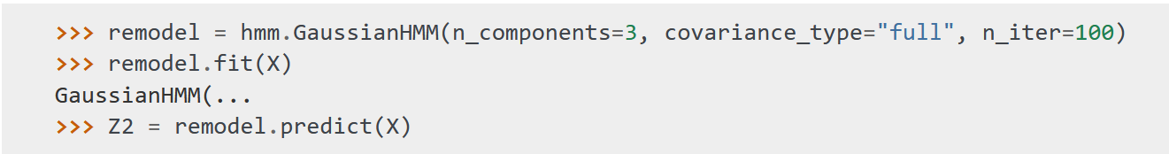
Tool: Hmm Learn
Initializing and Sampling a Model
Learning

Slide 26
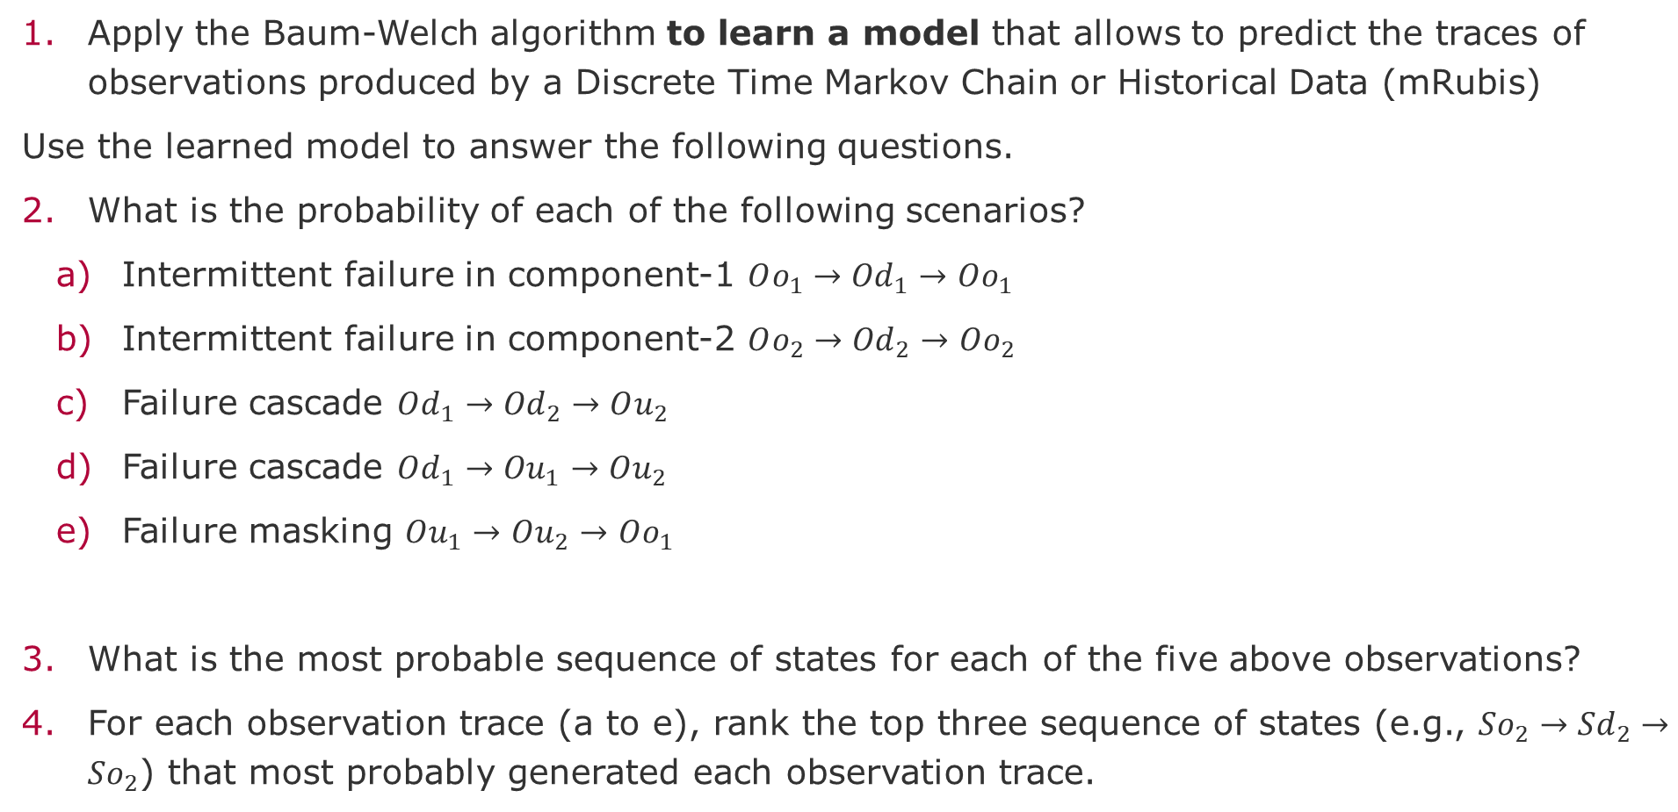
Interesting Questions for Practice
Apply the Baum-Welch algorithm to learn a model that allows to predict the traces of observations produced by a Discrete Time Markov Chain or Historical Data (mRubis)
Use the learned model to answer the following questions.
What is the probability of each of the following scenarios?
Intermittent failure in component-1 $Oo_{1}→{Od}_{1}→Oo_{1}$
Intermittent failure in component-2 $Oo_{2}→{Od}_{2}→Oo_{2}$
Failure cascade $Od_{1}→{Od}_{2}→Ou_{2}$
Failure cascade $Od_{1}→{Ou}_{1}→Ou_{2}$
Failure masking $Ou_{1}→Ou_{2}→Oo_{1}$
What is the most probable sequence of states for each of the five above observations?
For each observation trace (a to e), rank the top three sequence of states (e.g., $So_{2}→{Sd}_{2}→So_{2}$) that most probably generated each observation trace.

Slide 27
Task-2
Apply the Baum-Welch algorithm to learn a model for your mRubis scenario
Generate a sequence of observations from your DTMC that correspond to the three scenarios:
Intermittent failure
Failure cascade
Failure masking
Use your learned model to
Compute the probability of each scenario
Estimate the sequence of states that most probably generated each observation trace

Slide 28

Some derivations
1. What is the probability that a model generated a sequence of observations?
$$P\left(O | θ\right), where O=O_{1}→O_{2}→ …→O_{T−1}→O_{T},θ=\left(S,O,A,B,π\right),S=S_{1}→ S_{2}→…→S_{T−1}→S_{T}$$
$$P\left(O | (S,θ)\right)= \prod_{t∈T}{P(O_{t}|{(S}_{t},θ))}$$
2. What is the probability of seeing the sequence of observations $O$ and sequence of states $S$?
$P\left((O,S) | θ\right)=P\left(O | (S,θ)\right)∗P(S|θ)$ Chain Rule
Expression of seeing a particular sequence of observations $O$ given sequence of states $S$ and model $θ$:
$P\left(O | (S,θ)\right)=b_{s1}\left(O_{1}\right)∗b_{s2}\left(O_{2}\right)∗…{∗b}_{sT}(O_{T})$
Expression of seeing a particular sequence of states $S$ given a model $θ$:
$$P\left(S | θ\right)=π_{s1}{∗a}_{s1}∗a_{s2}∗a_{s2}{∗a}_{s3}∗…{∗a}_{sT−1}{∗a}_{sT}$$
$$P\left(O | θ\right)=\sum_{i∈P}{P\left(O | {(S}_{i},θ)\right)∗P(S_{i}|θ)}, where P is permutations of states S_{t}$$

Slide 29

Computing $P(O|θ)$
$P\left(O | θ\right)=\sum_{i∈P}{P\left(O | {(S}_{i},θ)\right)∗P(S_{i}|θ)}, where P is permutations of states S_{t}$
Intractable! , given $T$ observations and $N$ states, we get:
State sequences = $N^{T}$
Multiplications per state = $2T −1$
Total summations and multiplications = ($2T−1)N^{T}+{(N}^{T}−1)$
If $T =6$observations and $N=4$ states, we get
$$\left(2∗6−1\right)∗4^{6}+\left(4^{6}−1\right)$$
$11∗4096+4096−1 =49152$ summation and multiplications
If $T = 18∗3=54$ and $N=18∗2=36$
$\left(2∗54−1\right)∗{36}^{54}+\left({36}^{54}−1\right)$ $108∗1.09∗{10}^{84}+1.09∗{10}^{84}−1 \sim {10}^{86}$ summation and multiplications

Slide 30
End

Slide 31
Supervisory Component

